Slide 1
Item Tracker
Jigar Patel

Slide 2
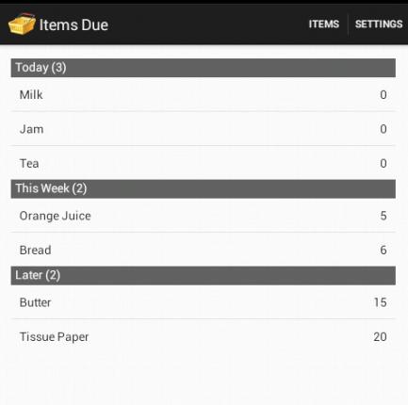
Overview
Reminds user to buy items which have either gone out of stock or are going to get out of stock soon
User can see what is due today, this week or later
This list can be used as shopping list
More useful for frequently bought items

Slide 3
Implementation – High Level
User
Notification
Item Update Service
Items Due Activity
Items database
System Alarm
Items Usage Activity
Settings

Slide 4
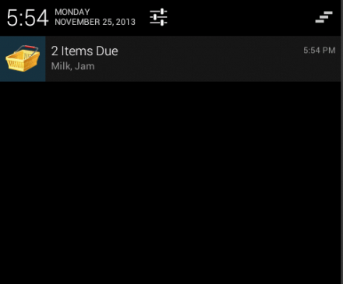
Output - Notification and Items Due

Slide 5
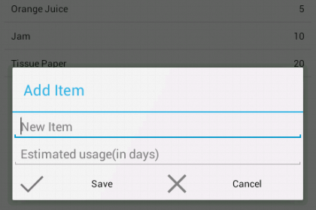
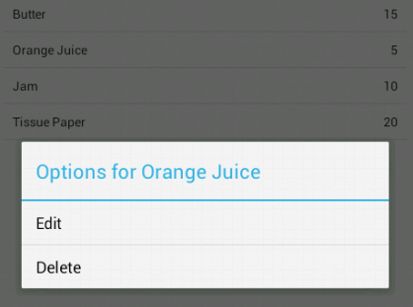
Flow – Items Usage
User enters items he wants to track for the first time along with its usage duration in days.
And he can update it any time later. System automatically takes care of updating days left.

Slide 6
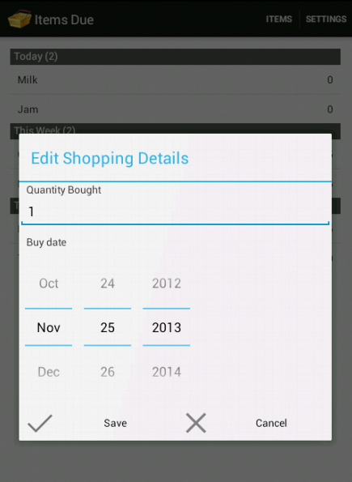
Flow – User Buys Items
Whenever user goes to shopping, he indicates which item has been bought
By single click user indicates that he bought default quantity and bought it today
Otherwise he needs to long press and edit as shown. This allows him to enter buying details even after shopping date

Slide 7
Storage Details
App remembers following things about items and uses them to create the notification and due list – uses SQLite
Field Name | Use
Name | Name of item
Remind In Days | Estimated Usage Duration in days
Days Left | Days left before stock gets over
Last Updated At | Used to calculate days left properly even when Update service is called after many days

Slide 8
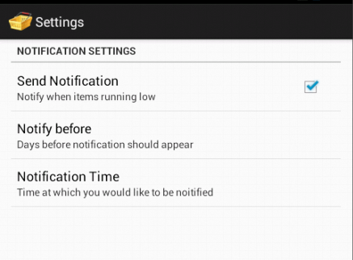
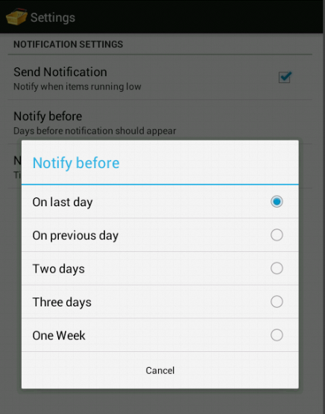
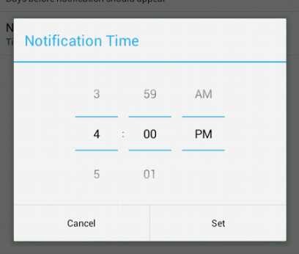
Settings
User can enable/disable notification and set the notification time and days before when he wants to be notified

Slide 9
DEMO
Enter one sample item
Buy using singe click
Buy using edit screen
Settings
Notification Time and Notification

Slide 10
Questions?
jjpatel@andrew.cmu.edu

